Slide 1
NOMAD progress slides
Stepanka Lankova

Slide 2

NOMAD Oasis
Docker – package everything an app needs (code, libraries, setting…)
Docker image – the blueprint or “recipe”
Docker container – the running instance built from the blueprint
custom image → custom container app with GUI
image can be edited by admins

Slide 3
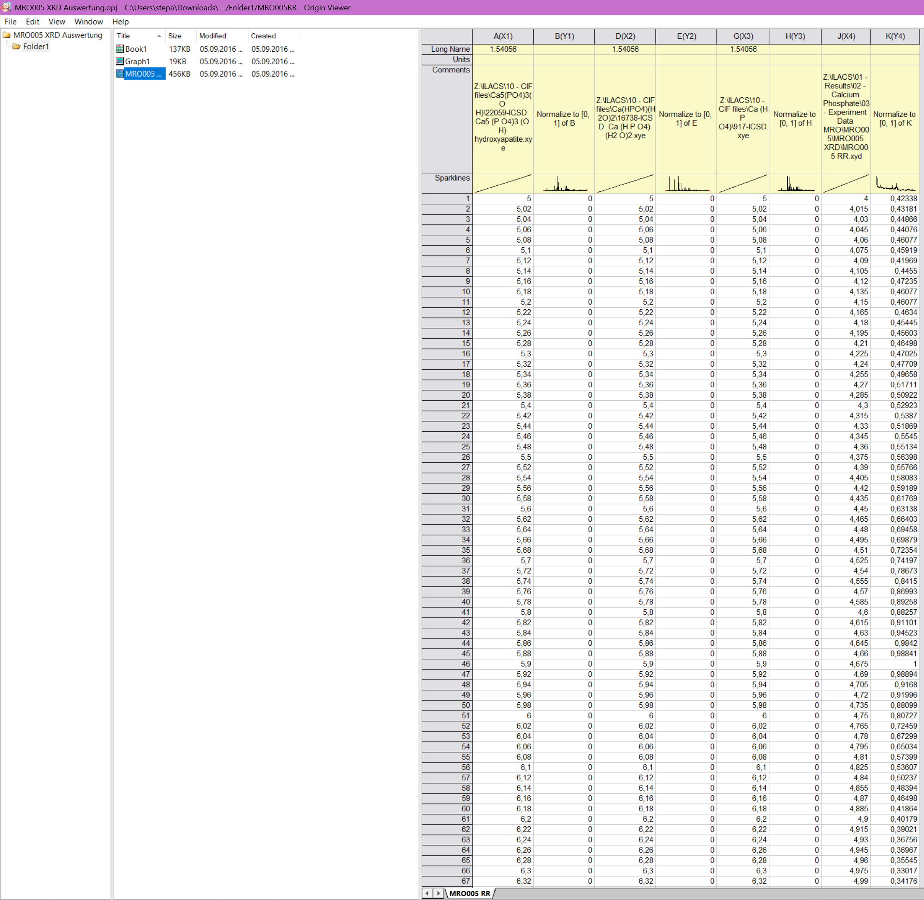
27.01.2026
Talk with Jes
XRD in NOMAD
Are the calculated data also uploaded into Origin?
Where are they coming from – how do I get them?
add an option to load more files for reference
Canada?

Slide 4
26.02.2026
implemented the reference files for .cif
the coordinates are computed and graphed once the .cif is uploaded
shows structure of the reference molecule
one can upload the pictures of the setup, caption them
next: luminiscence

Slide 5
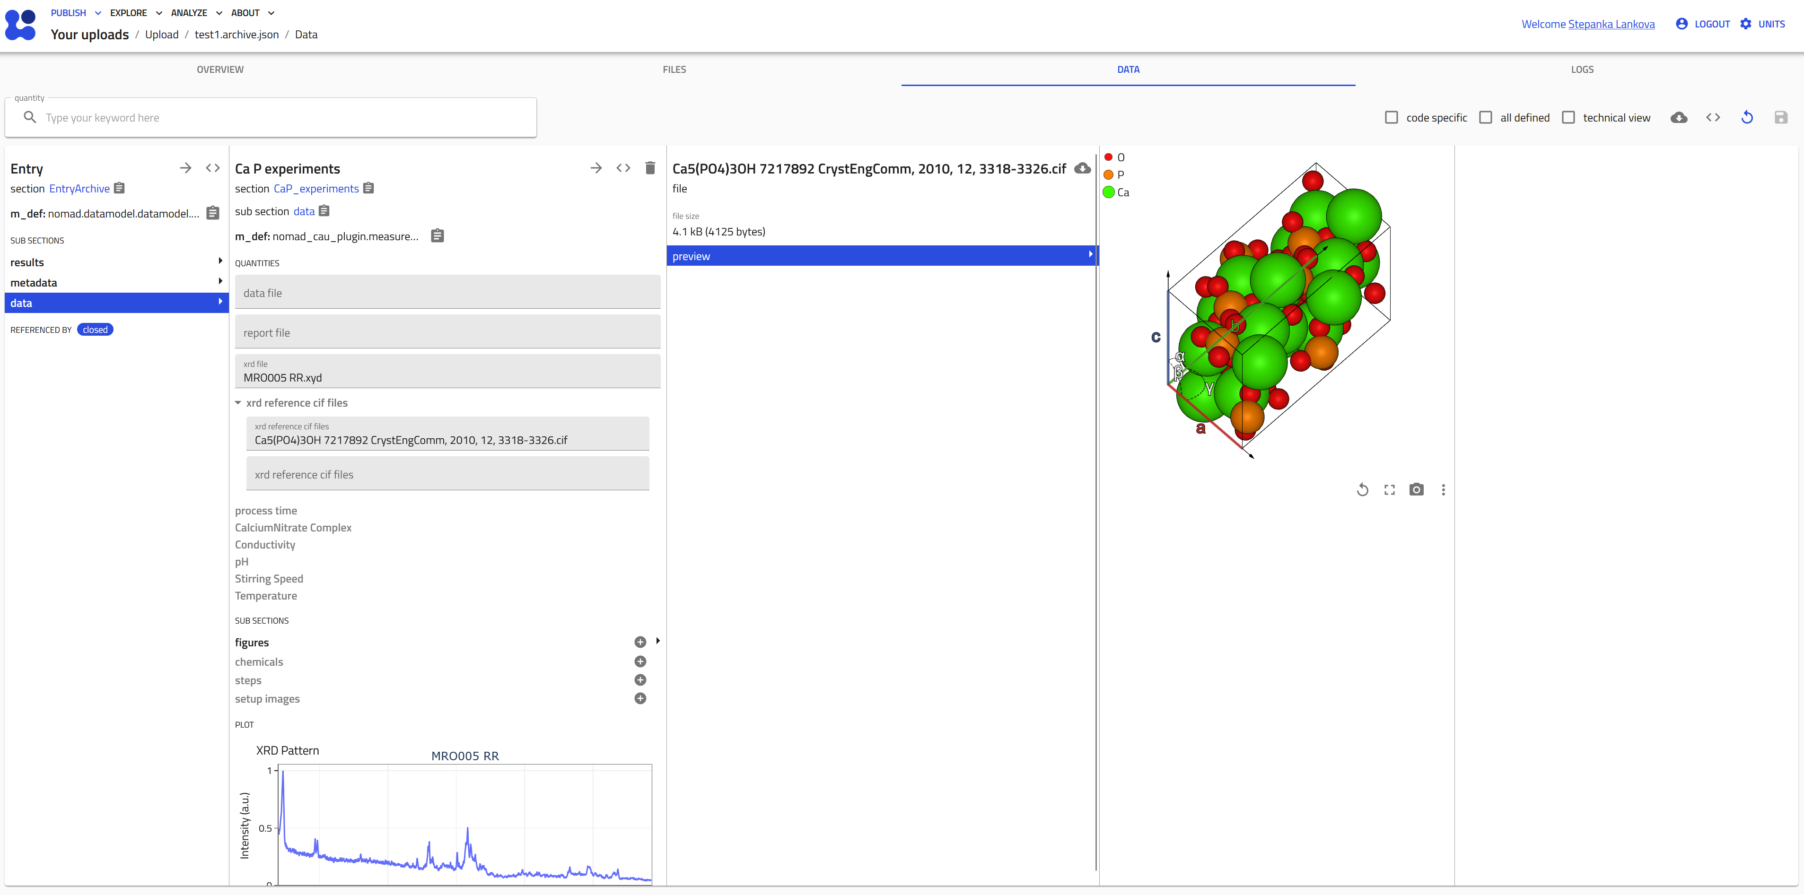
26.02.2026

Slide 6
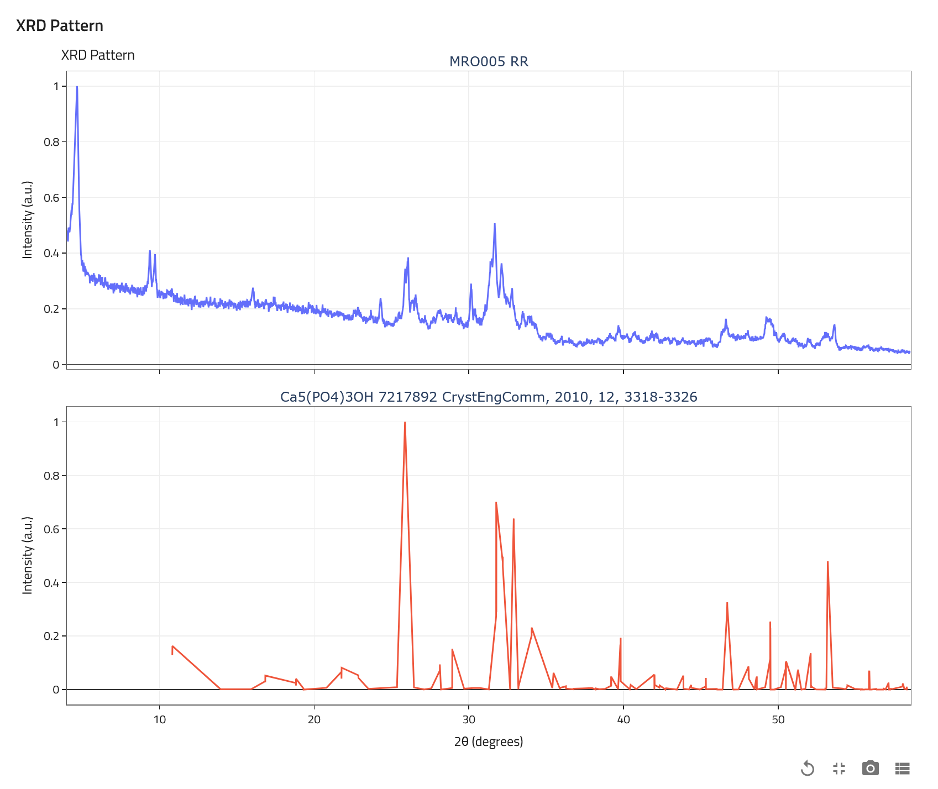
26.02.2026
It computes a theoretical powder diffraction pattern with pymatgen:
It instantiates pymatgen.analysis.diffraction.xrd.XRDCalculator.
It calls get_pattern(structure, two_theta_range=(min_2θ, max_2θ)).
Result is a pymatgen pattern object containing:
peak positions in 2θ (degrees)
corresponding simulated intensities (typically normalized so max is ~100)
https://pymatgen.org/pymatgen.analysis.diffraction.html#module-pymatgen.analysis.diffraction.xrd
Notes:
choose the wavelengh → manual wavelength input,

Slide 7
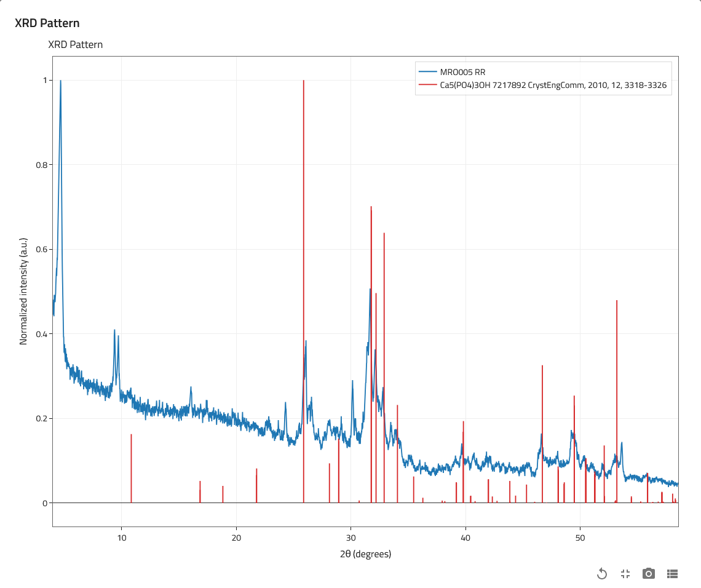
12.03.2026
Happy (yesterday’s) Birthday!
implemented the XRD peaks
origin file interpretation

Slide 8
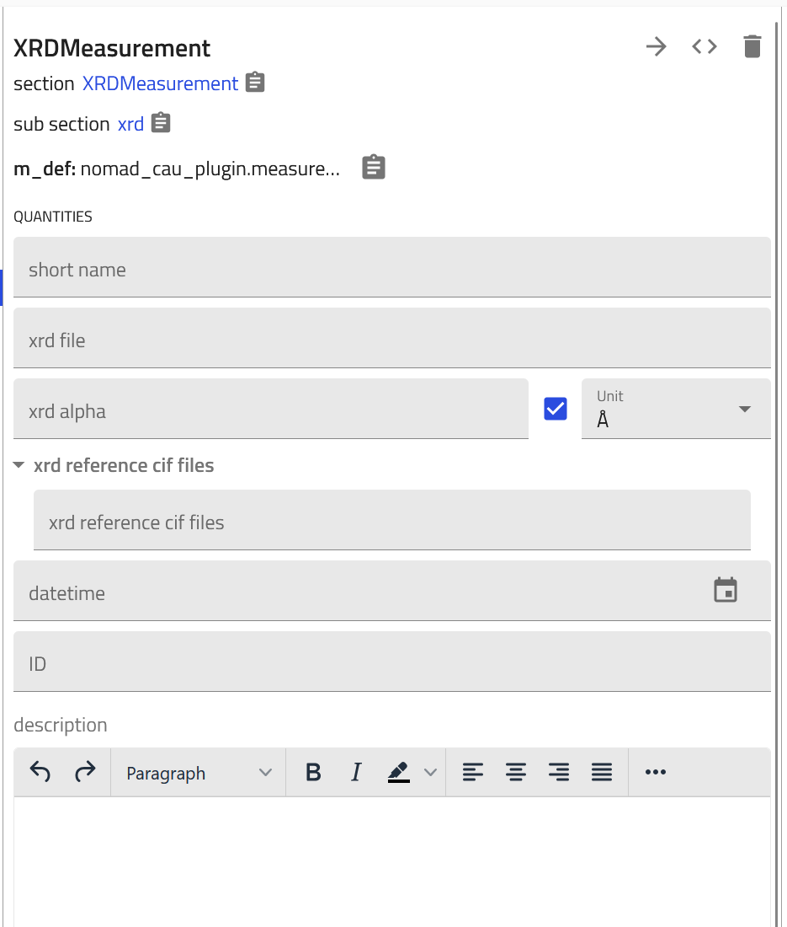
09.04.2026
luminescence implemented (next slide)
user can select alpha
414.04 EUR not reimbursed ~ 30 hours
Trip to Kiel in May?

Slide 9
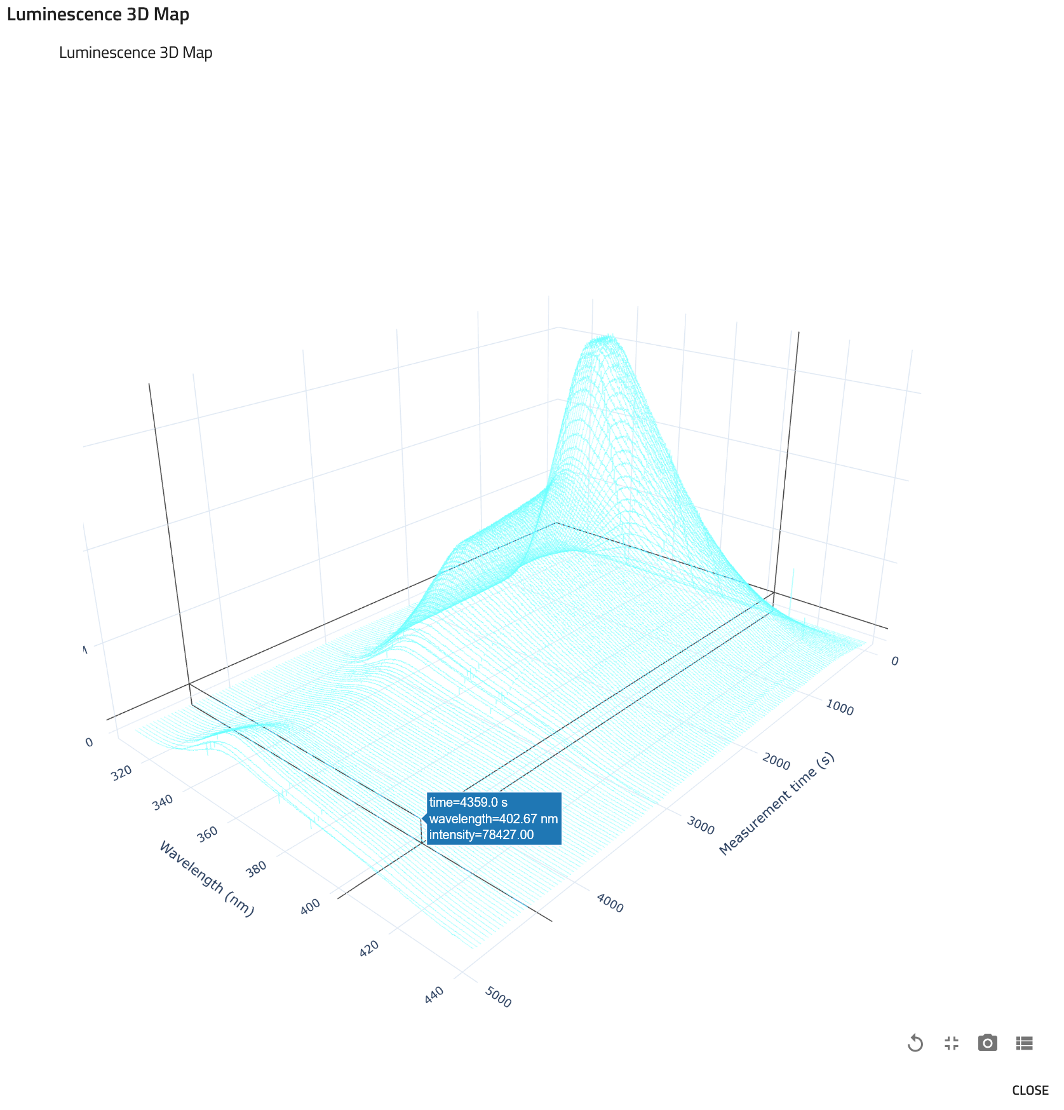
luminescence

Slide 10
30.04.2026
meeting with Michaela
structure of schema:
synthesis
refinement
characterization
excel sheet of chemicals used in the lab

Slide 11
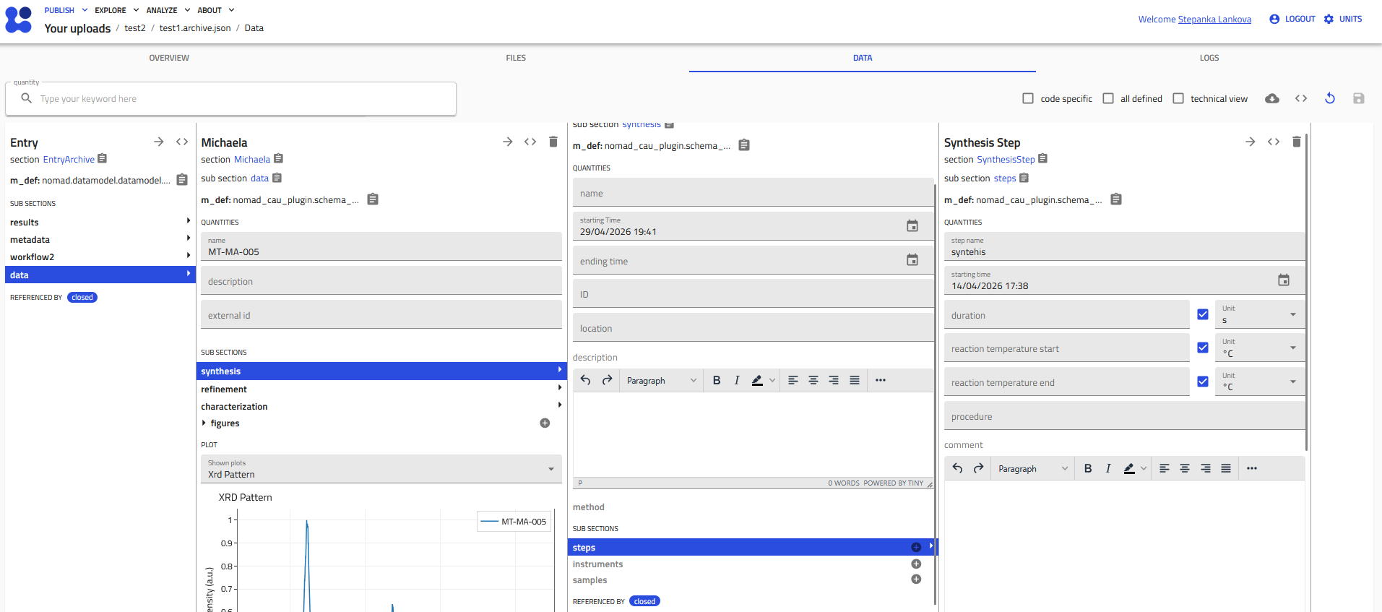

Slide 12
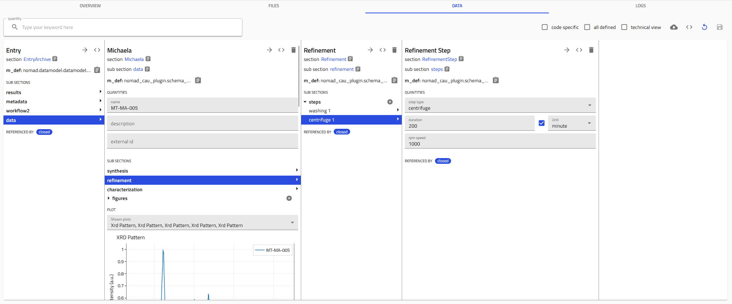

Slide 13
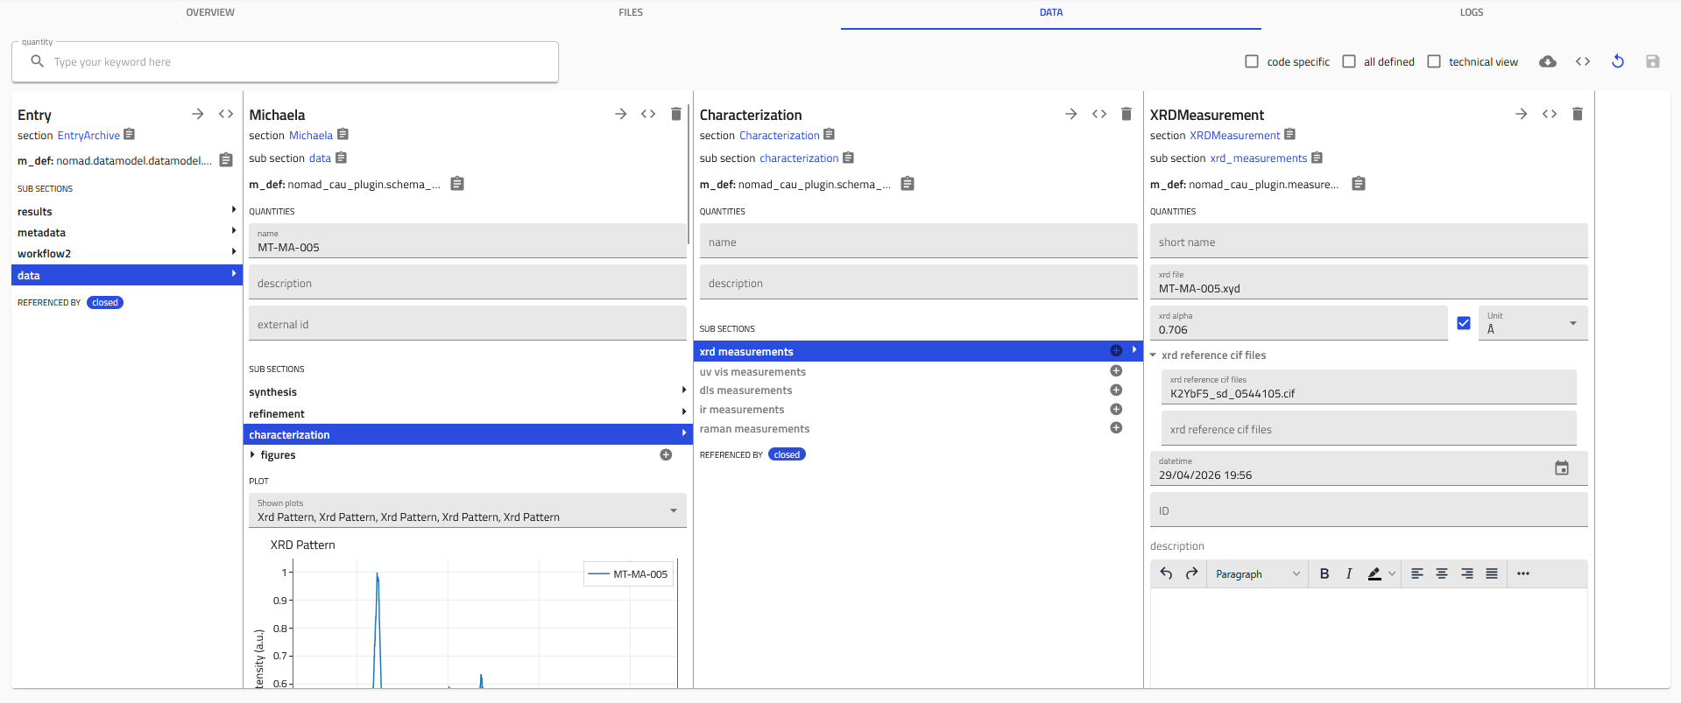

Slide 14
21.05.2026
a little issues with Nomad Oasis updates
schema for Michaela now has functional:
XRD in Q (some issue I haven’t figured out yet)
DLS measurement
IR measurement
remaining:
UV-VIS (in progress)
Raman

Slide 15
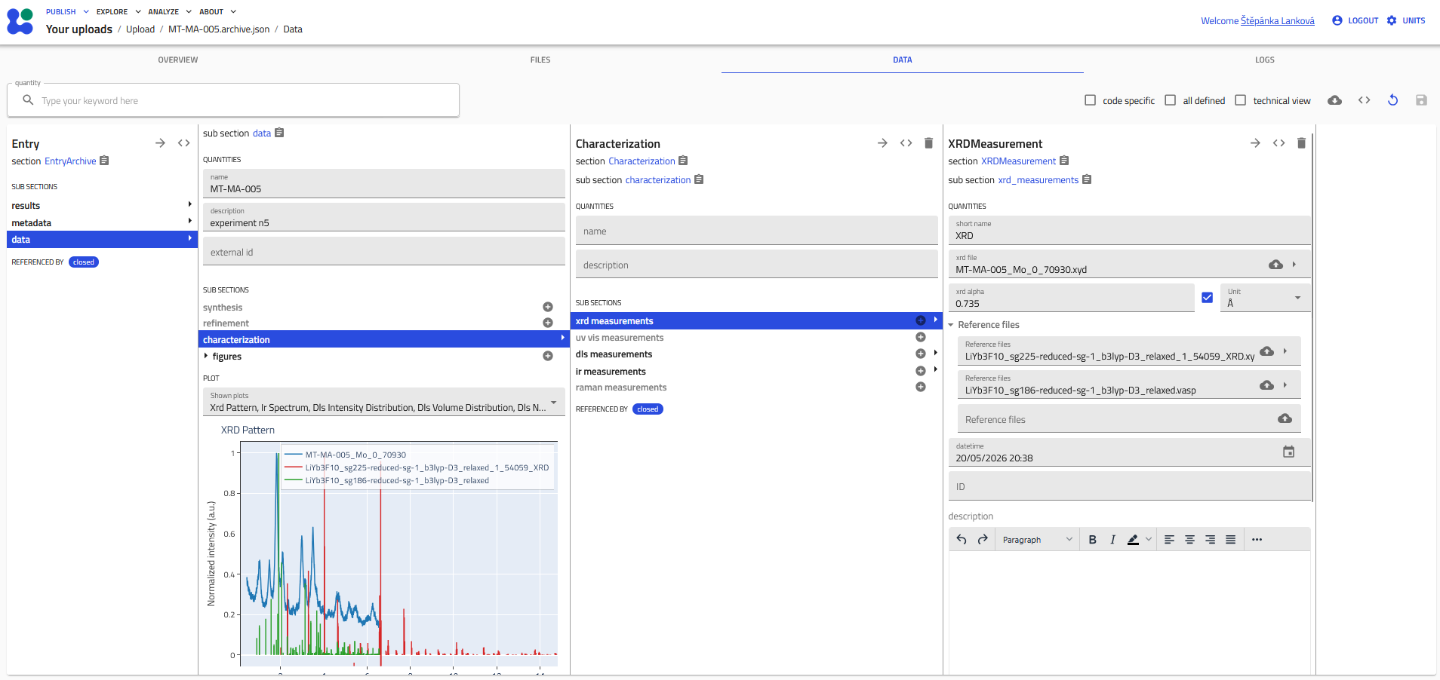

Slide 16
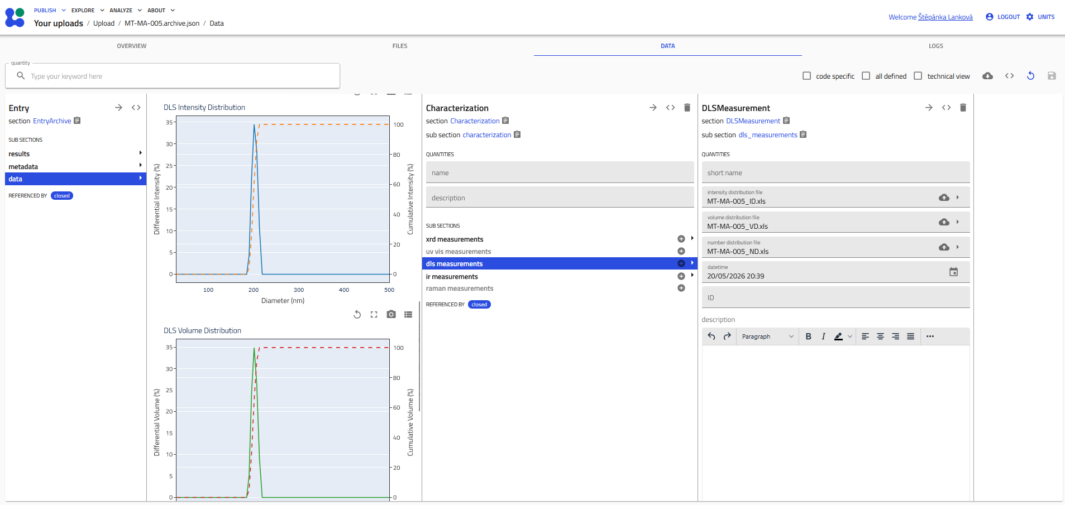

Slide 17
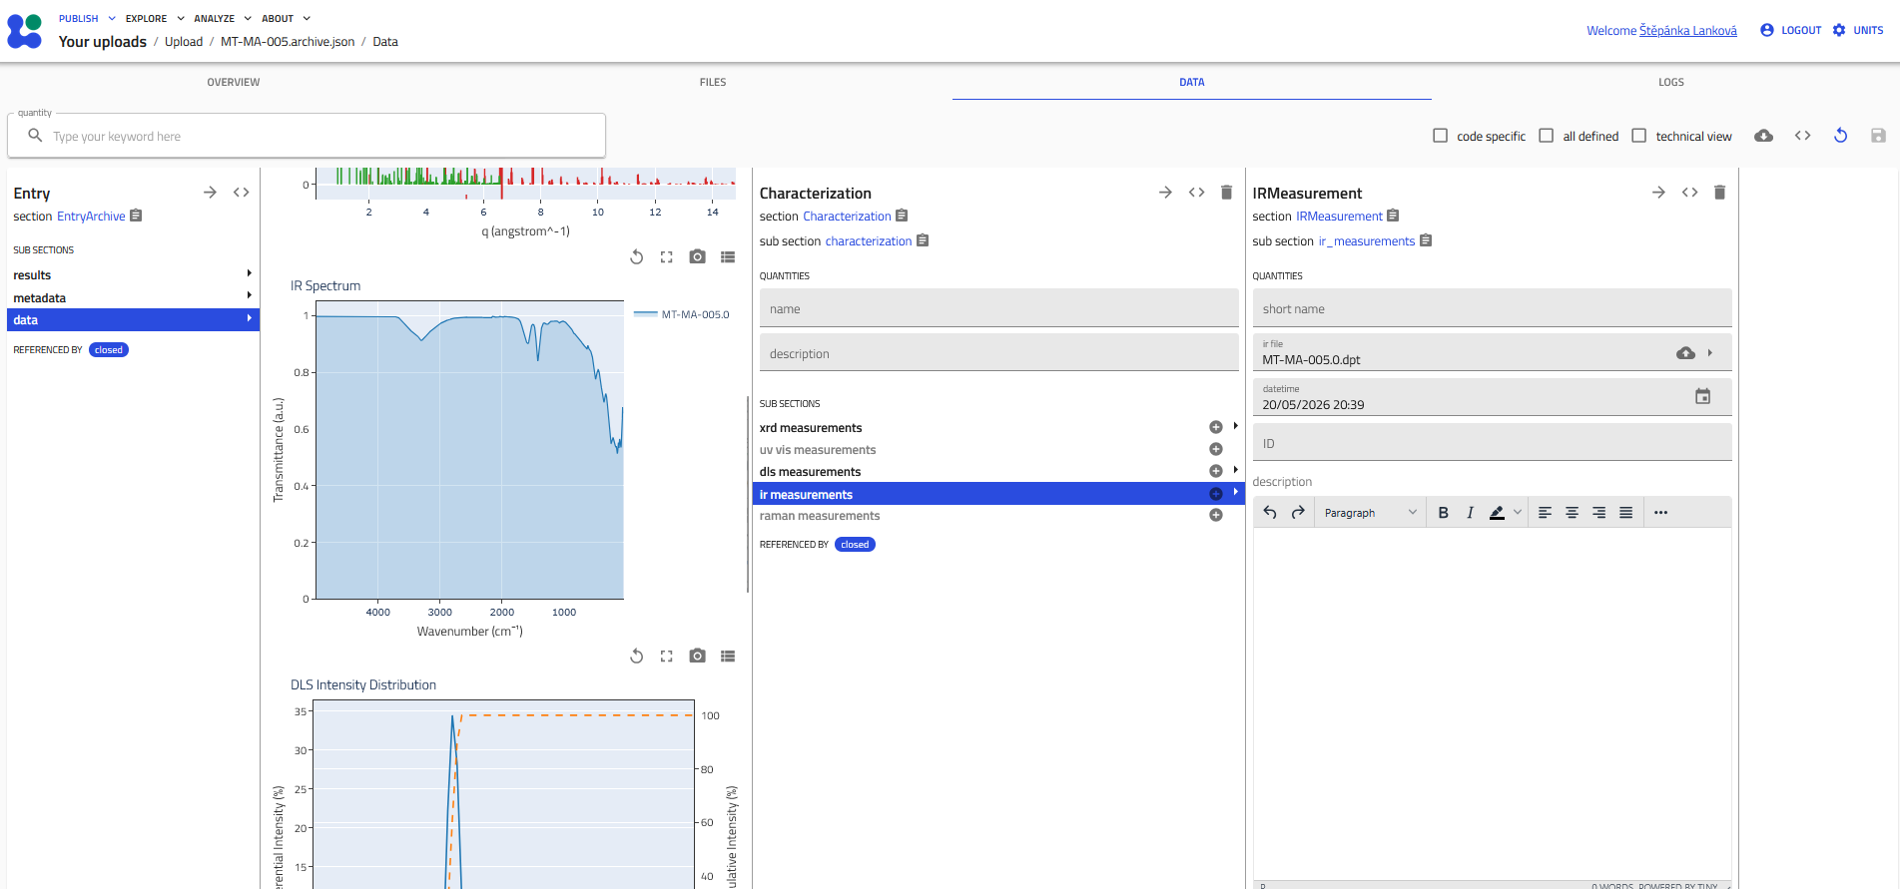

Slide 18
10.06.2026
XRD figure is now correct
each reference file to have its own alpha??
UV-VIS also implemented
waiting for chemical list and Raman from Michaela

Slide 19
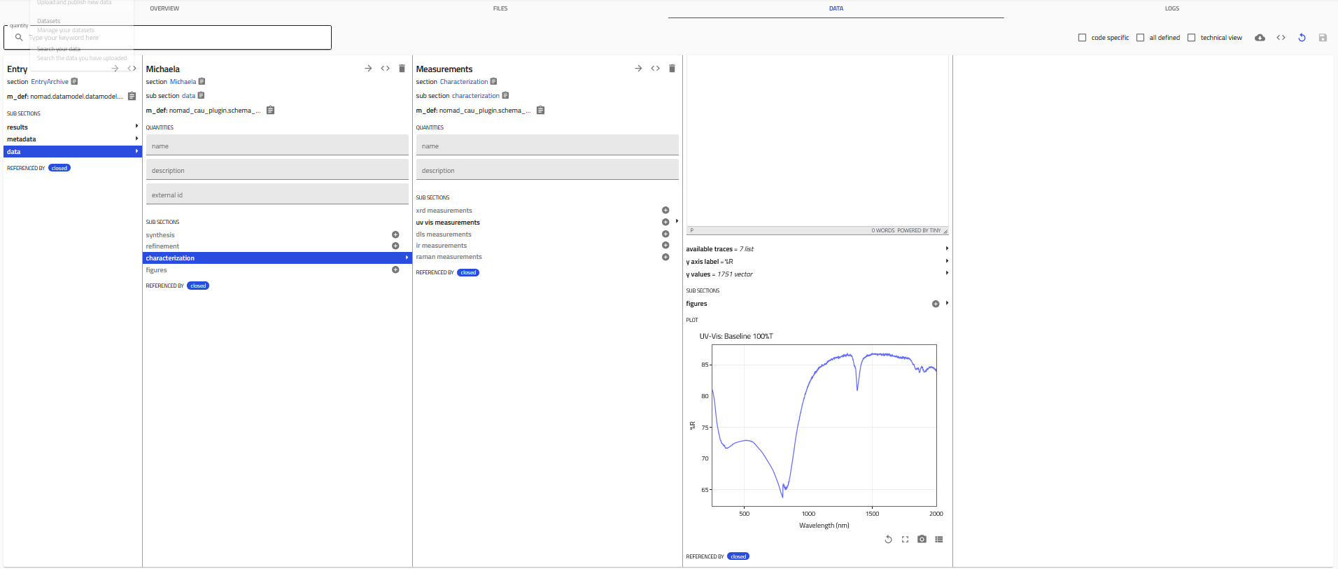

Slide 20
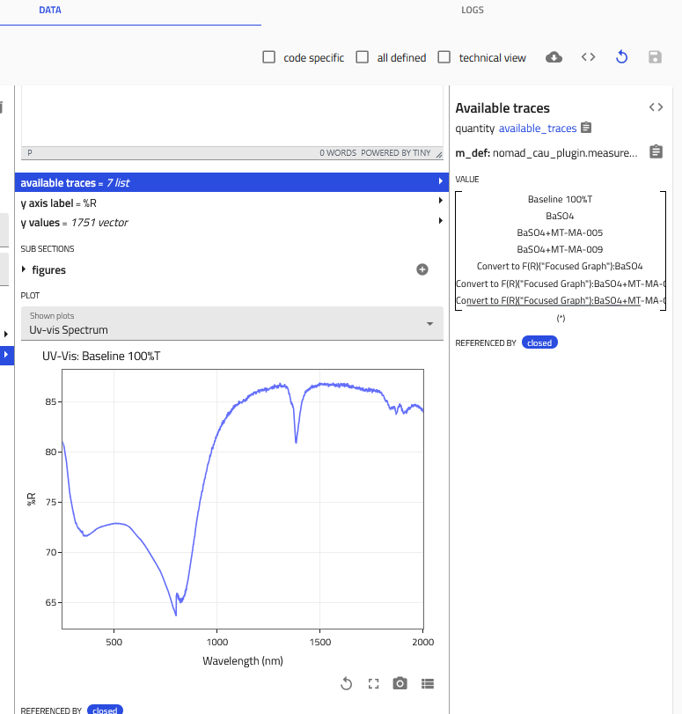

Slide 21
